Slide 1
PERFORMANCE ANALYSIS OF MINIMUM SPANNING TREE ALGORITHMS Prim’s and Kruskal’s Algorithm
SUMUKHA BHAT
YASH SHAH

Slide 2
WHAT IS MINIMUM SPANNING TREE?
A MINIMUM SPANNING TREE IS THE ONE THAT CONTAINS THE LEAST WEIGHT AMONG ALL THE OTHER SPANNING TREES OF A CONNECTED WEIGHTED GRAPH. THERE CAN BE MORE THAN ONE MINIMUM SPANNING TREE FOR A GRAPH. IT IS A SET OF EDGES IN AN UNDIRECTED WEIGHTED GRAPH THAT CONNECTS ALL THE VERTICES WITH NO CYCLES AND MINIMUM TOTAL EDGE WEIGHT.

Slide 3
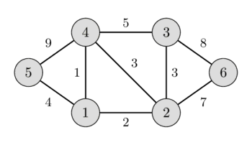
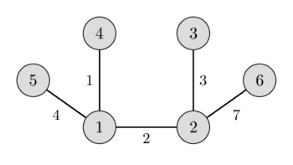
STEPS FOR PRIM’S
STEP 1 - CHOOSE A RANDOM VERTEX AS STARTING VERTEX AND INITIALIZE THE MINIMUM SPANNING TREE.
STEP 2 - FIND THE EDGES THAT CONNECT TO OTHER VERTICES.FIND THE EDGE WITH MINIMUM WEIGHT AND ADD IT TO THE SPANNING TREE.
STEP 3 - REPEAT STEP 2 UNTIL THE SPANNING TREE IS OBTAINED.

Slide 4
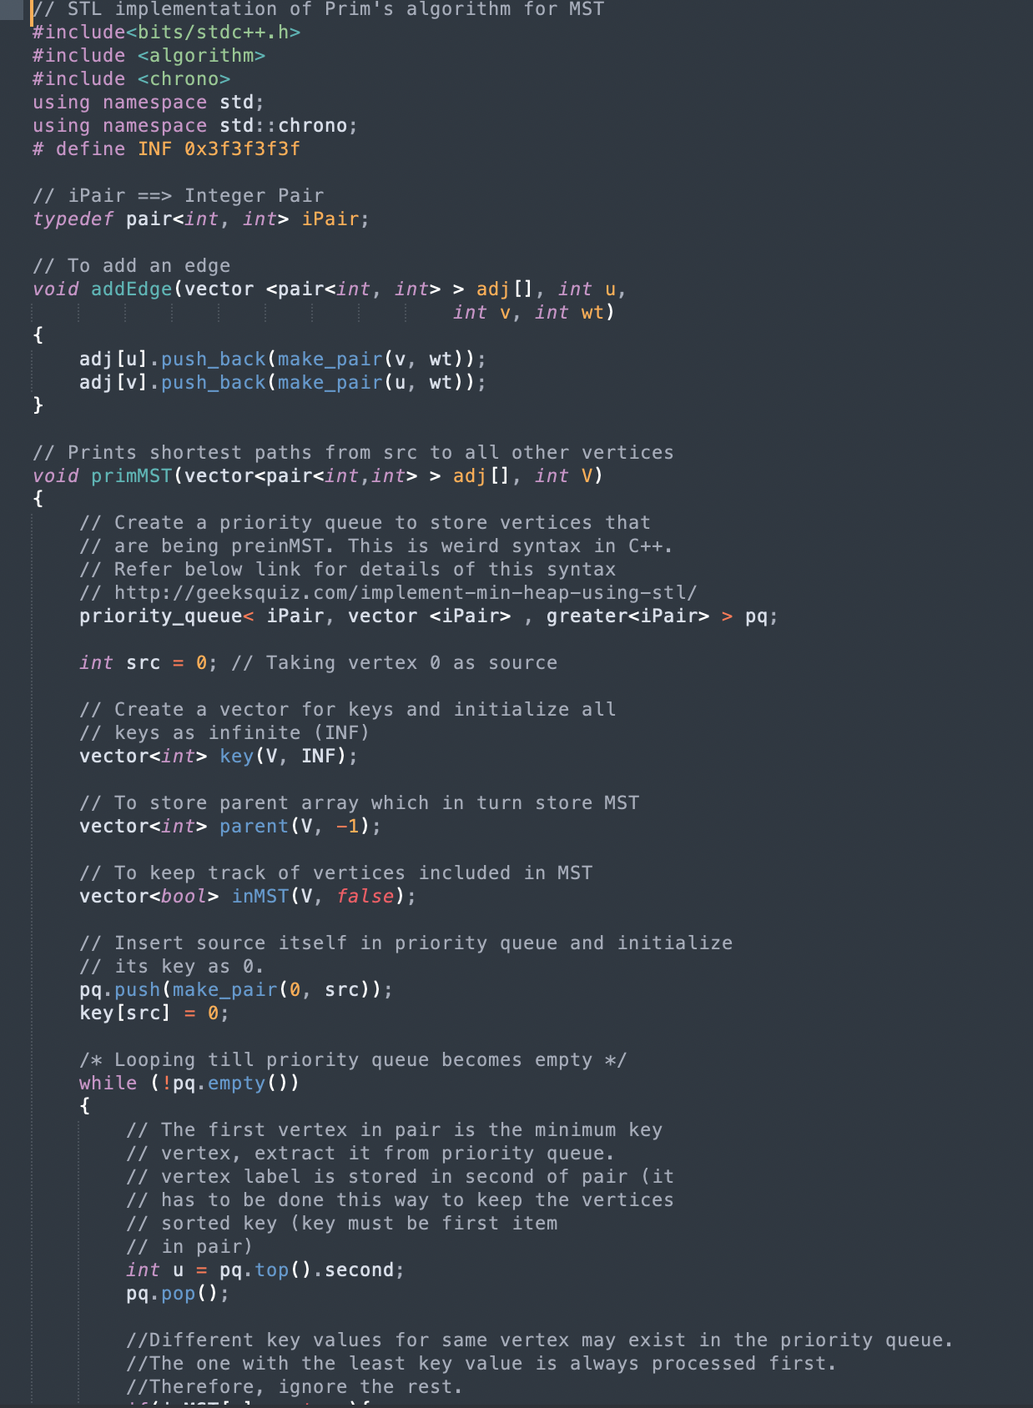
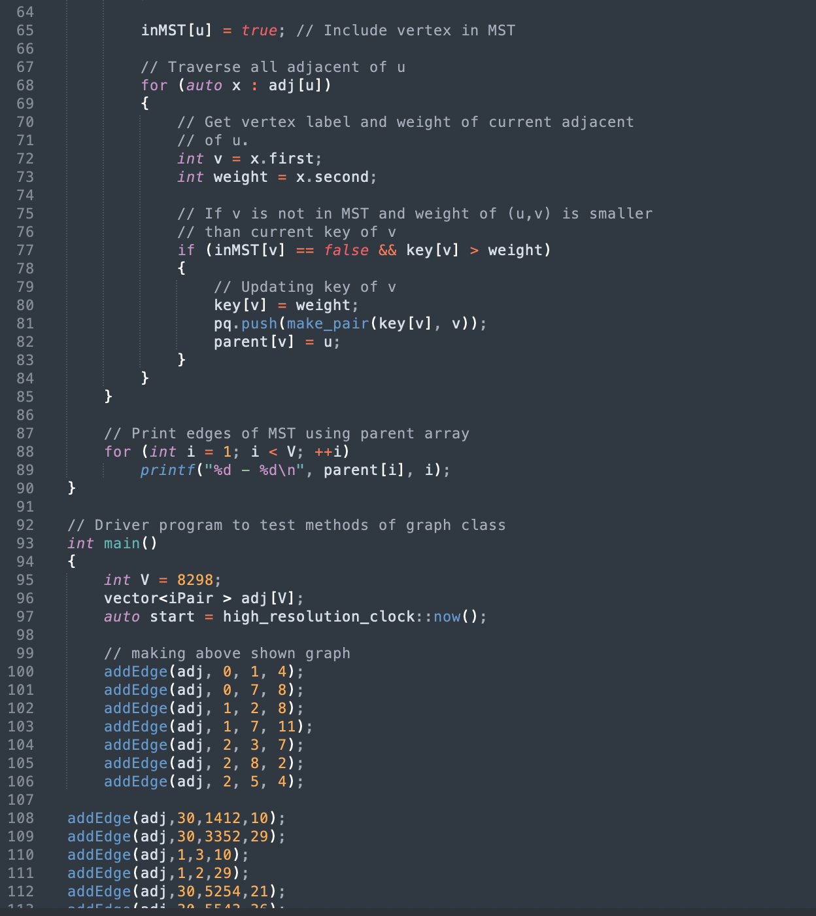

Slide 5
STEPS FOR KRUSKAL’S
STEP 1 - FIRST SORT ALL THE EDGES FROM THE LOWEST WEIGHT TO HIGHEST.
STEP 2 - TAKE EDGE WITH THE LOWEST WEIGHT AND IT TO THE SPANNING TREE. IF THE CYCLE IS CREATED , DISCARD THE EDGE.
STEP 3 - KEEP ADDING EDGES LIKE IN STEP 1 UNTIL ALL THE VERTICES ARE CONSIDERED.

Slide 6
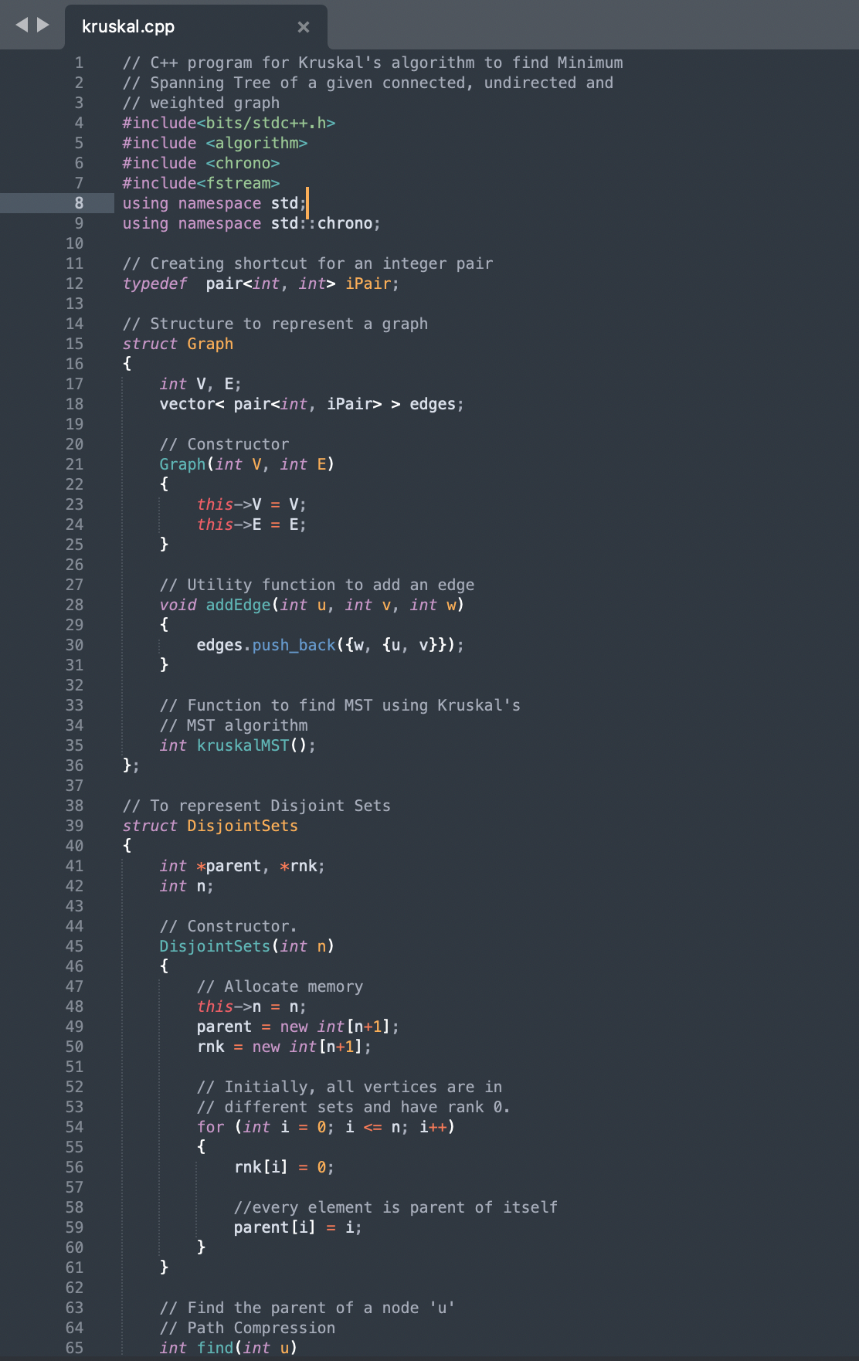
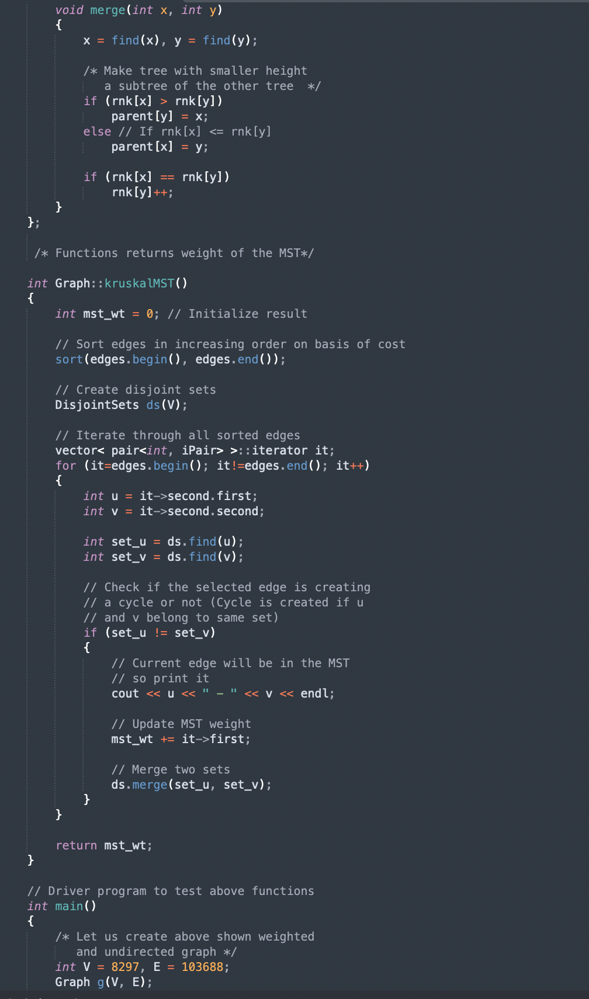

Slide 7
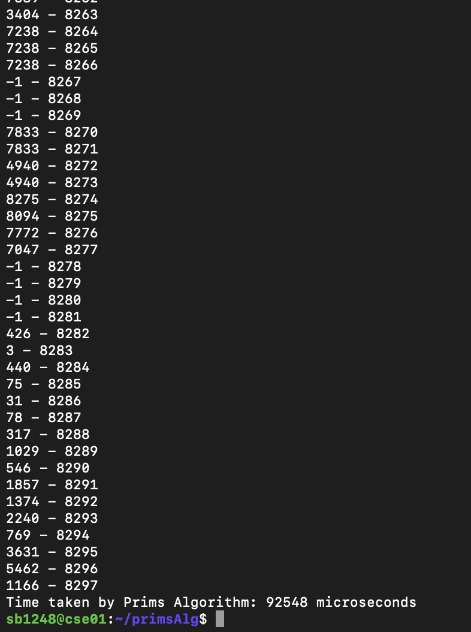
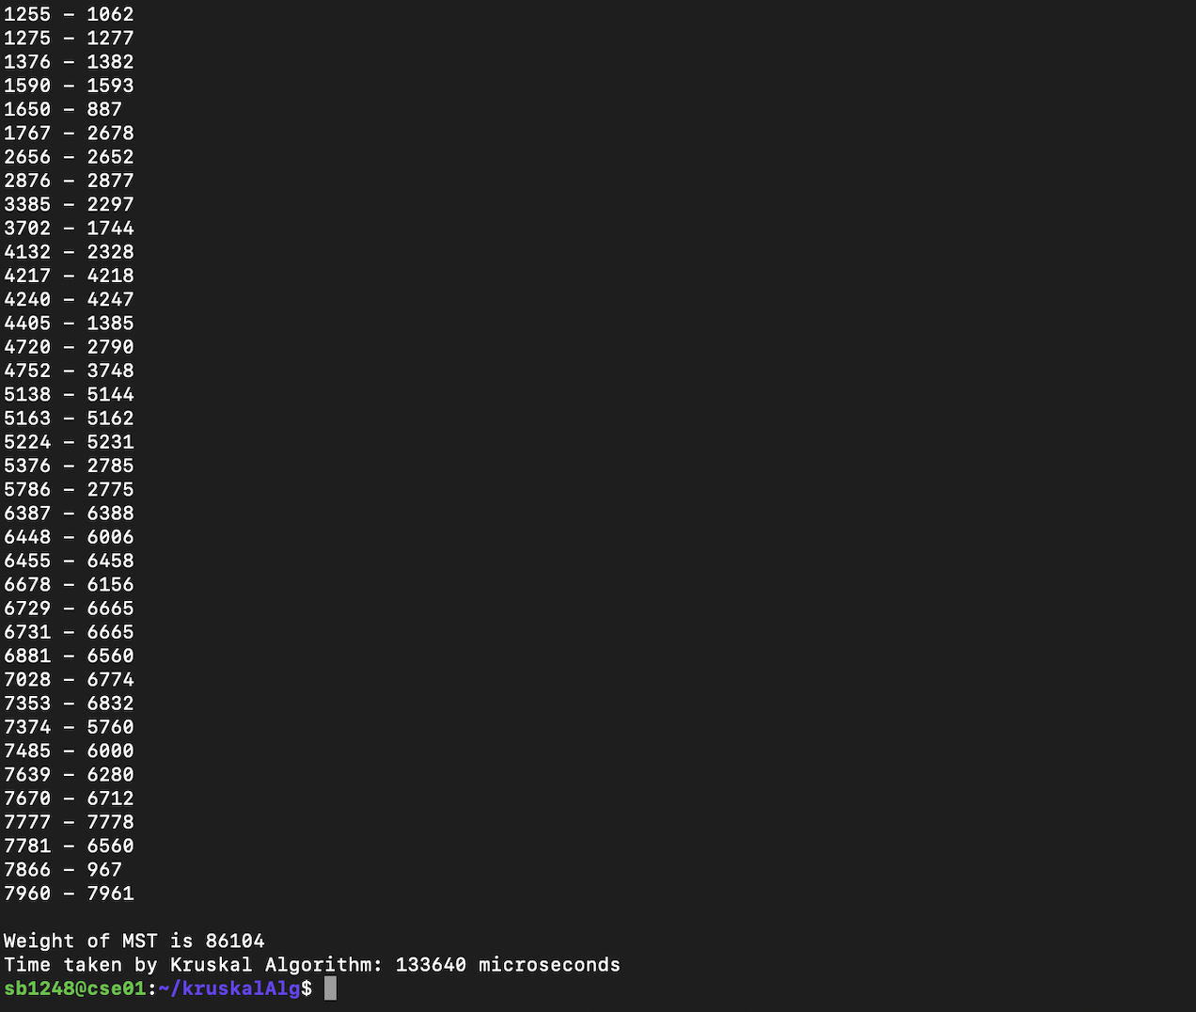

Slide 8
Elapsed Time for various test cases
No.of nodes | No. of edges | Kruskal’s(ms) | Prim’s(ms)
7 | 21 | 3.102 | 2.844
8 | 28 | 3.069 | 4.197
9 | 36 | 5.303 | 4.224
10 | 45 | 6.169 | 6.725
50 | 200 | 10.453 | 11.004
289 | 817 | 21.790 | 20.984
1019 | 3679 | 51.278 | 52.768
8224 | 105000 | 130.134 | 94.450

Slide 10

Thank You

